Slide 1
Microsoft AI Skills Fest
Notes:
Intro slate

Slide 2
AI in action: Unlock productivity at work
Jumpstart your AI learning journey | English
Notes:
1 min | Opening (Slide 2)
[Opening Scene: Instructor on camera, welcoming participants with an engaging and enthusiastic tone.]
Instructor: Hello and welcome! I’m thrilled to have you here for "AI in Action: Unlock Productivity at Work."
My name is <name>, and I’m a <my role> at Microsoft. I’m here to guide you through this fast-paced, interactive session where you’ll discover practical ways AI can simplify your work, reduce errors, and free up time—so you can focus on what truly matters.
And the best part? You don’t need to be an AI expert to benefit from this!
Before we dive in, let’s take a moment to set ourselves up for success. (Transition to the next slide)

Slide 3

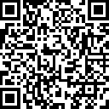
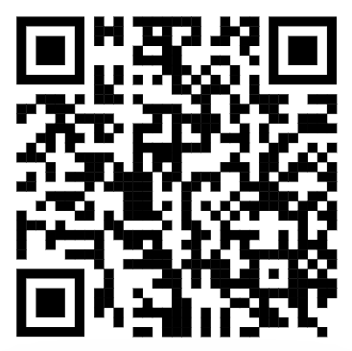
Welcome to Microsoft AI Skills Fest!
Quick reminders before we begin
1
2
3
Join our fun GUINNESS WORLD RECORDS™ title attempt
Be ready for an interactive exercise using Microsoft Copilot
Ask questions and share your thoughts
Earn your badge:
Step 1: If you haven’t yet, take a moment to register: https://aka.ms/AISkillsFest
Step 2: Attend this session
Step 3: Complete a final step (shared at the end)
How? Open Copilot in another browser
With your peers and our Microsoft AI Experts (“Live Moderators”) in the chat
https://copilot.microsoft.com/
Notes:
30 sec | [Slide: Session Housekeeping & Setup] (Slide 3)
Here are a few quick reminders to get the most out of this session:
Join the GUINNESS WORLD RECORDS™ challenge!
If you haven’t registered yet, take a moment now so you don’t miss out on this exciting record-breaking attempt.
You’ll be asked to provide an email where we’ll send your badge after the session.
How to earn your badge? Attend this session and complete a simple step we’ll share at the end!
There will be a mini-interactive exercise using Microsoft Copilot. To get ready, let’s open Copilot in another browser tab so you’re all set when we get to that part.
Engage with your peers and experts! Learning is better when we do it together. Drop your questions and thoughts in the chat as we go. We have Microsoft AI experts on standby, ready to help.
Great! Now that we’re set up, let’s talk about what we’ll be covering today.

Slide 4
Together, we’ll explore
7 min
Welcome & Unlock your AI mindset
6 min
Meet your AI work buddy: How AI can help you
15 min
Solve real-life work problems with AI: Discover your AI Kickstarter
12 min
Practice basic prompts with a mini exercise
10 min
Plan small, easy actions: Quick wins to work smarter
Notes:
30 sec | [Slide: Quick Session Overview] (Slide 4)
Over the next 50 minutes, we’ll take a journey together to:
Unlock your AI mindset and explore how AI can support your work.
Meet your AI work buddy and understand how AI fits into daily tasks.
Explore how AI can solve real-life work problems and discover your own AI Kickstarter task.
Get started with basic prompts with a mini-interactive exercise.
And finally, plan small easy actions for simple next steps to work smarter with AI
By the end, our goal is for you to feel excited, confident, and ready to apply AI to your workflow and enhance your productivity

Slide 5
1: Welcome & Unlock your AI mindset
To maximize your learning today

Slide 6






Just for fun
Where you are connecting from
An adjective that represents how you feel about AI in the chat
Let’s share in the chat…
Notes:
1 min | [Slide: Icebreaker – Chat Activity] (Slides 5-6)
Let’s start with a quick icebreaker! In the chat, type two things:
Where you’re joining from
An adjective that describes how you feel about AI today
I'll give you a few seconds to share...
[Instructor pauses for 30 sec, then reacts to the chat responses.]

Slide 7
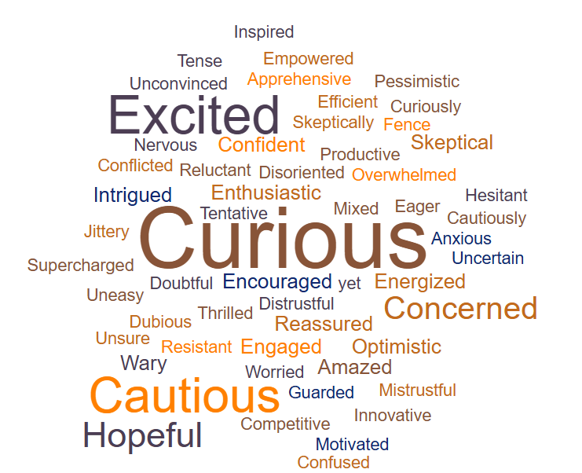
It’s natural to feel many different feelings
Let’s imagine
You magically gained 2 extra hours every week.
What would you do?
Notes:
2 min | [Slide: Reframing AI Feelings into Opportunities] (Slide 7)
What adjectives are you seeing from your peers? In past sessions, we have seen a mix of emotions—excited, curious, skeptical, cautious, or even unsure where to start. And that’s completely natural! AI is a big topic, and everyone’s journey looks different—whether you’re new to AI or already experimenting with it in your work.
Now, Let’s try something different.
[Click animation to show the question]
Imagine you magically gained two extra hours every week—no strings attached. What would you do with that extra time?
Drop your answers in the chat!
[Instructor pauses, reacting to responses.]
Great answers! If I had 2 extra hours every week, I’d spend more time with family, work on passion projects, go for a walk, or simply breathe between meetings.
Well, here’s the good news—AI can help make that happen.
By offloading repetitive tasks and working smarter, not harder, we can create more time for what truly matters.

Slide 8

Our simple goal for today is
Helping you discover your “AI Kickstarter”
What’s my “AI Kickstarter”— one small way I can turn these feelings into a real opportunity for my role and impact today?
Notes:
30 sec | [Slide: Your AI Kickstarter] (Slide 8)
So, our simple goal for today is to help you find one simple way AI can create an opportunity for you and your work.
Let’s call this your AI Kickstarter—a practical, easy way to put AI to work for you right away.
Maybe it’s something that helps you: automate a repetitive task, summarize information faster, or write emails more efficiently. And the best part? You don’t need to be an AI expert to start.
Are you ready to explore what’s possible? Let’s dive in!
[Instructor smiles and transitions into the next section.]

Slide 9
2: Meet your AI work buddy: How AI can help you
The essence of what you need to know about AI
Notes:
~1 min | [Opening Scene: Instructor on camera, transitioning smoothly from the previous segment.] (Slide 9)
Instructor: Now that we’ve set the stage for our AI journey, let’s talk about something even more exciting—how AI can actually help you in your day-to-day work.
We’ve all heard the buzz about AI, but what does it actually mean for you? How can AI fit into your workflow, simplify tasks, and help you work smarter—not harder?
To answer that, let’s start with a simple question: What is AI, and how does it work?

Slide 10


What is AI?
3 things to know about generative AI
1
Powered by LLMs: AI models trained on massive data to understand and generate human-like language
Works through prompting: Users provide input, and AI generate responses
Creates new content: Generates text, images, and more based on user input
2
3
Microsoft Copilot is one of the AI-powered productivity tools available today
Notes:
~1 min | [Slide: What is AI? Part 1] (Slide 10)
At its core, AI is designed to assist and amplify human productivity. But in recent years, one particular type of AI has been making headlines—Generative AI.
So what is Generative AI?
Generative AI is a type of artificial intelligence that focuses on creating new, unique content based on the input you provide. Let’s break this down:
Generative AI is powered by Large Language Models (LLMs). These are AI models trained on massive data to understand and generate human-like language
It works through "prompting." You provide AI with an input—like a question or request—and it generates a response based on that.
Creates new content – It can write, design, summarize, and generate content in ways that mimic human creativity.
And a great example of this? Microsoft Copilot. Copilot is one of the AI-powered productivity tools available today. It integrates into your existing workflows and acts as your intelligent assistant.

Slide 11

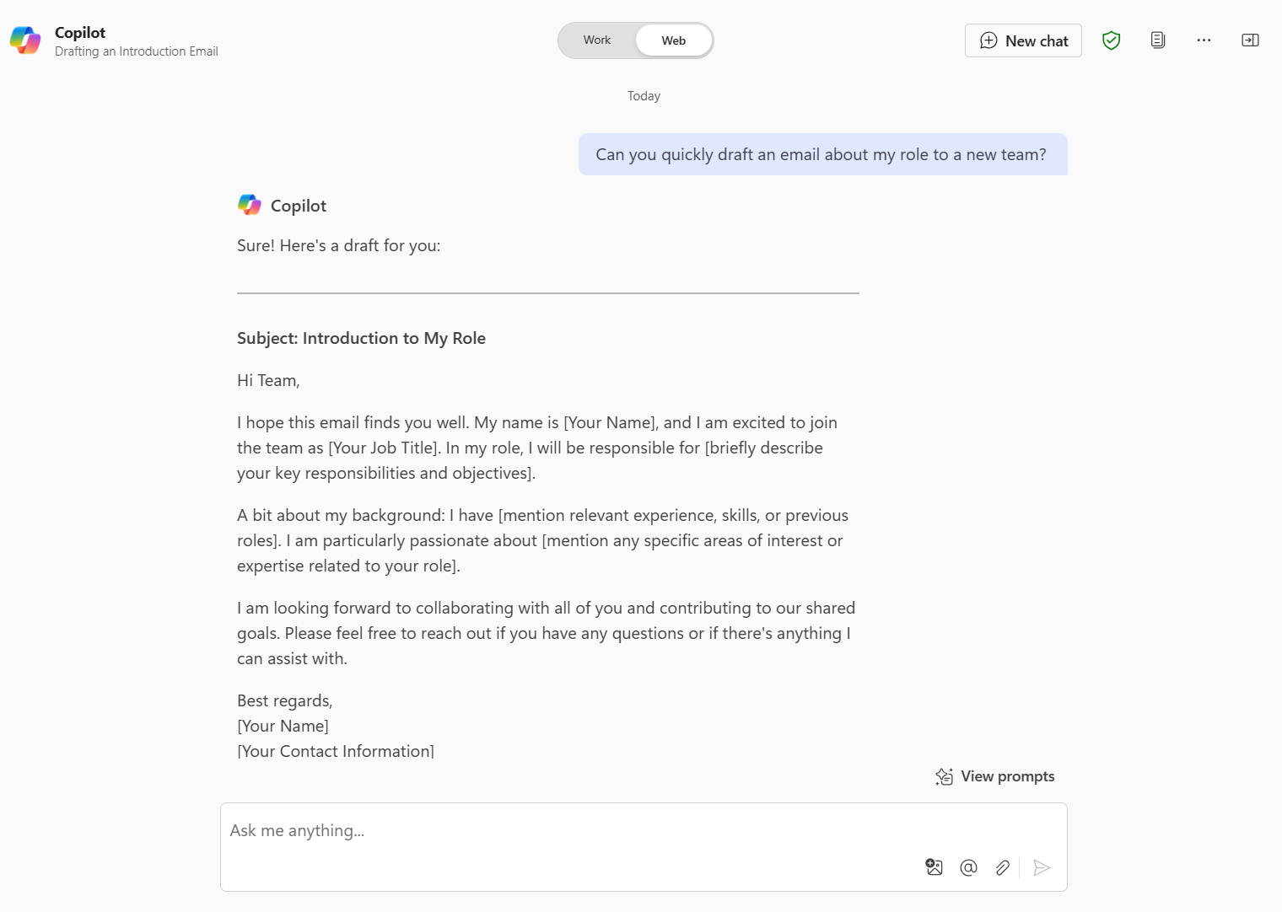
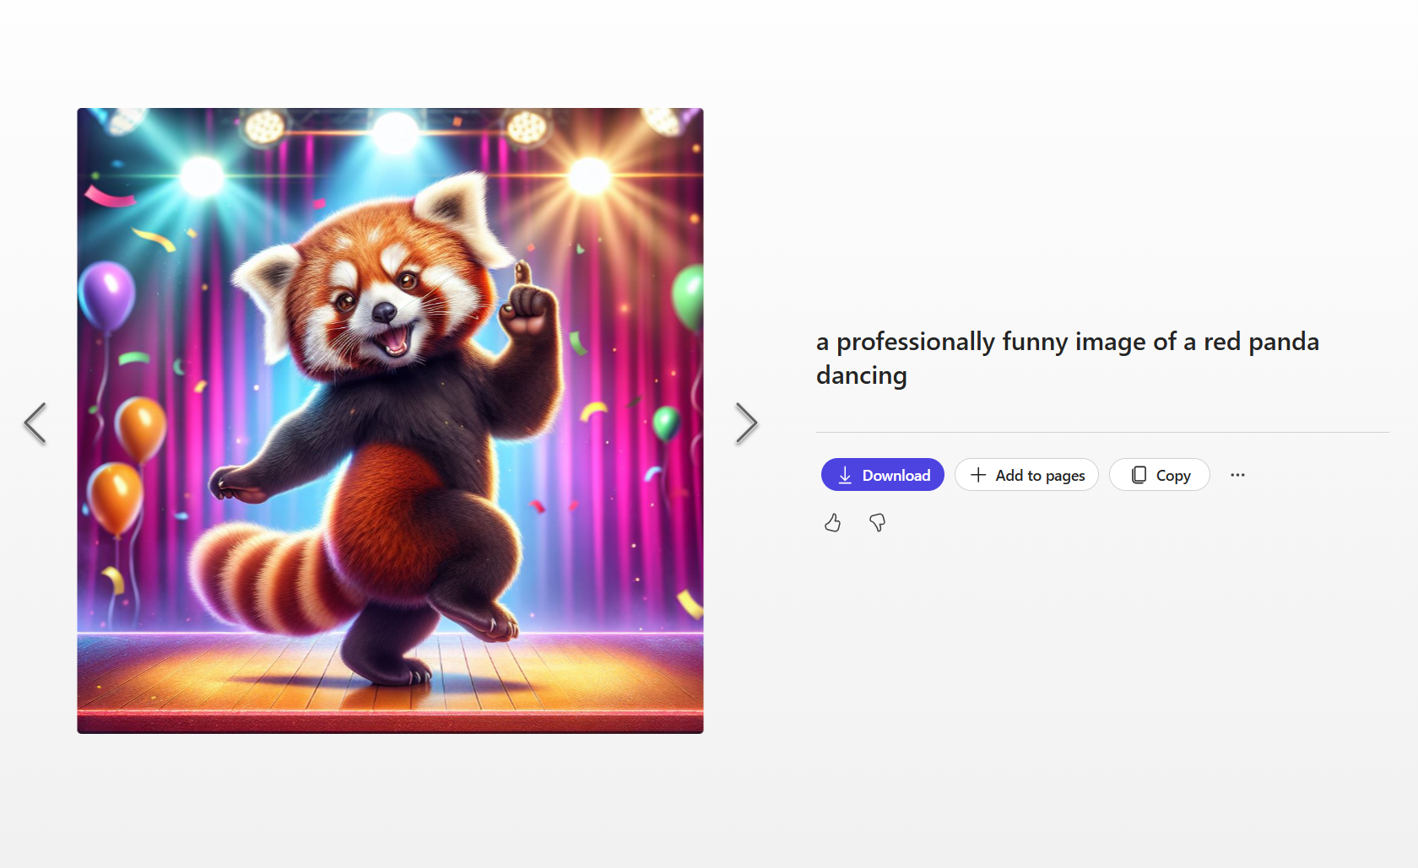
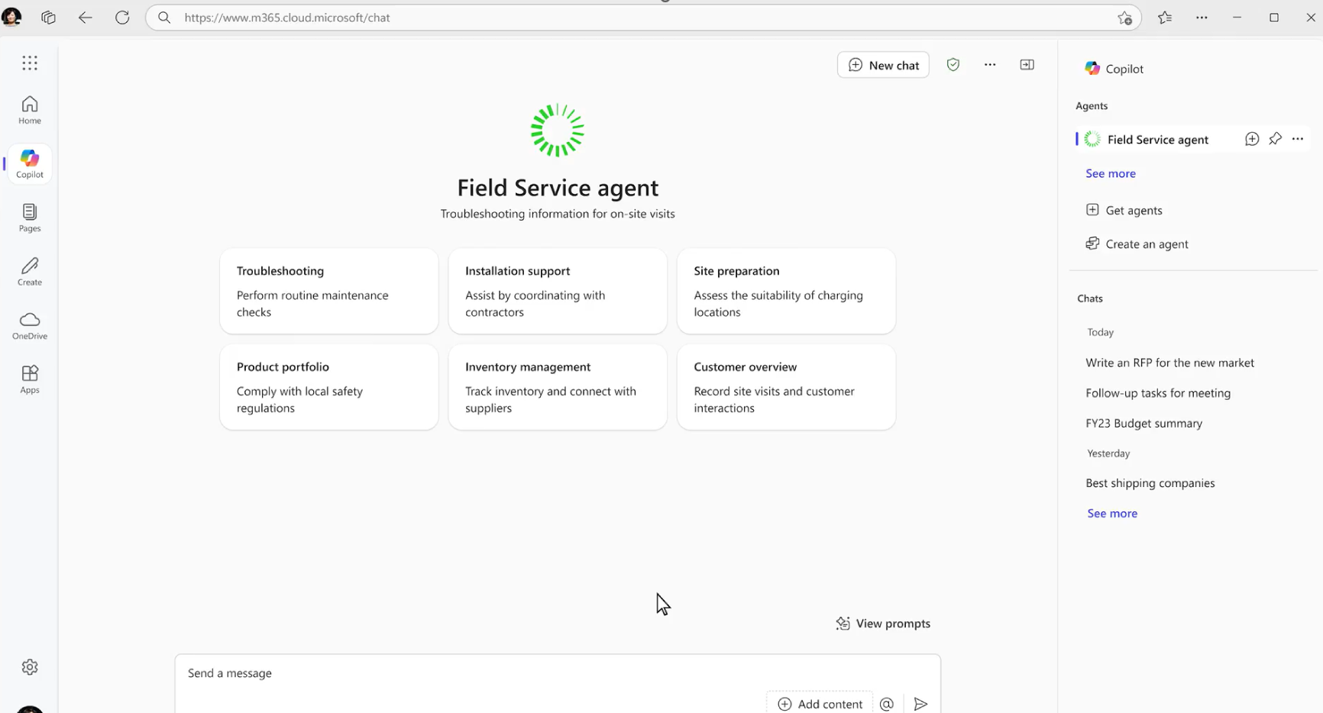
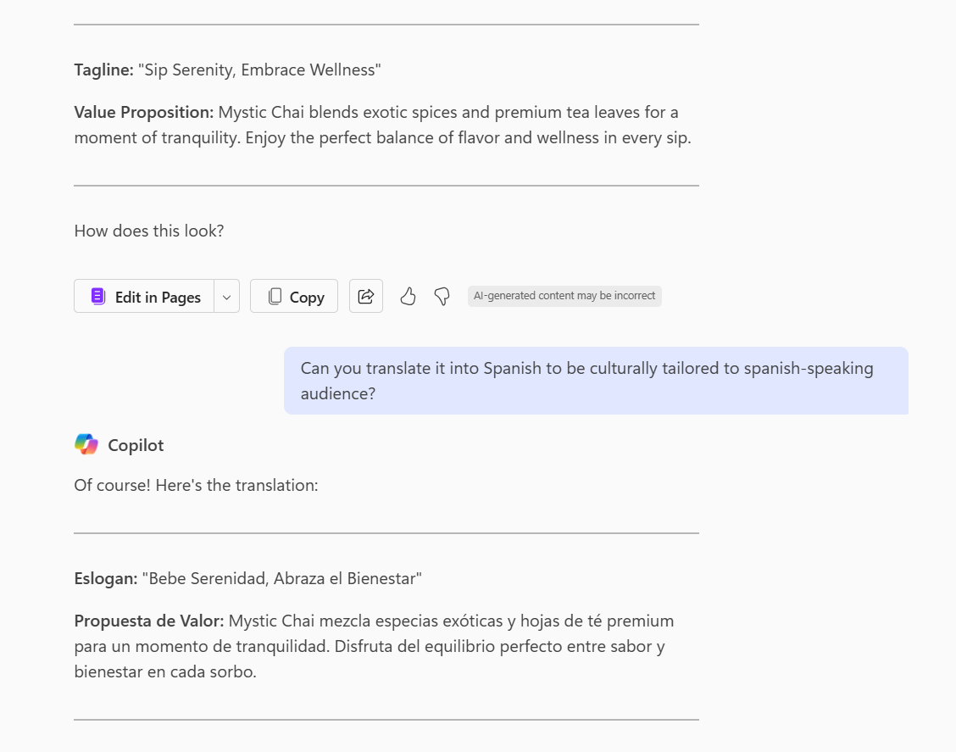
What are examples of AI usage?
What are some examples of generative AI today?
Quickly draft professional emails using Copilot
Create new images for products and services using M365 Copilot
"Hello"
“Hola"
Accelerate the localization of marketing campaigns with Copilot
Create customer service agent with Copilot Agent
Notes:
~1 min | [Slide: What is AI? Part 2] (Slide 11)
Here are some real-world examples of how AI is being used right now to improve productivity.
Drafting professional emails in seconds—Instead of spending time crafting emails, AI can suggest polished responses, saving you effort.
Generating high-quality images for branding, marketing, or product design—AI can create visuals instantly, replacing hours of manual work.
Translating and localizing content in minutes—Expanding your business or reaching global audiences can be easier with AI.
Creating AI-powered customer service agents—AI chatbots and virtual assistants are improving customer interactions and automating repetitive inquiries.
These are just a few ways AI is already transforming work. And, we’re just scratching the surface.

Slide 12
Why AI now? (1 of 2)
Work is moving faster, with more data, communication, and pressure to be productive. Learning to use AI effectively helps you stay relevant and succeed in your role as work continues to evolve
1
68%
79%
75%
Knowledge workers
Functional business roles
Data & IT professionals
Said Copilot helped them jump-start the creative process
Reported a reduction in administrative tasks
Spent less time searching for information
Work trend Index Annual Report: Will AI Fix Work? Microsoft. 9 May 2023
Microsoft Work Trend Index: What can Copilot’s Earliest Users Teach Us About Generative AI at Work?: Microsoft. 15 November 2023
Notes:
1 min | [Slide: Why Does AI Matter Now? Part 1] (Slide 12)
But let’s take a step back and ask: Why should we care about AI right now?
First of all, the reality is, work is moving faster than ever. Think about your own workday:
Information overload: We’re constantly bombarded with emails, documents, and reports.
Non-stop communication: Meetings, Online messages, endless notifications—it never stops.
Productivity demands: Teams are stretched thin, and leaders are looking for ways to do more with less.
With all of this happening, the pressure to stay efficient is greater than ever.
Organizations that adopt AI early will gain a competitive edge and build future-ready skills.
And we’re already seeing real-world impact. According to Microsoft’s Work Trend Index, AI is helping professionals across different roles—from knowledge workers to IT and business teams—be more productive, reduce manual tasks, and stay ahead in their work.
Learning to use AI effectively today equips us with the skills needed to thrive in our roles and workplaces of the future.

Slide 13
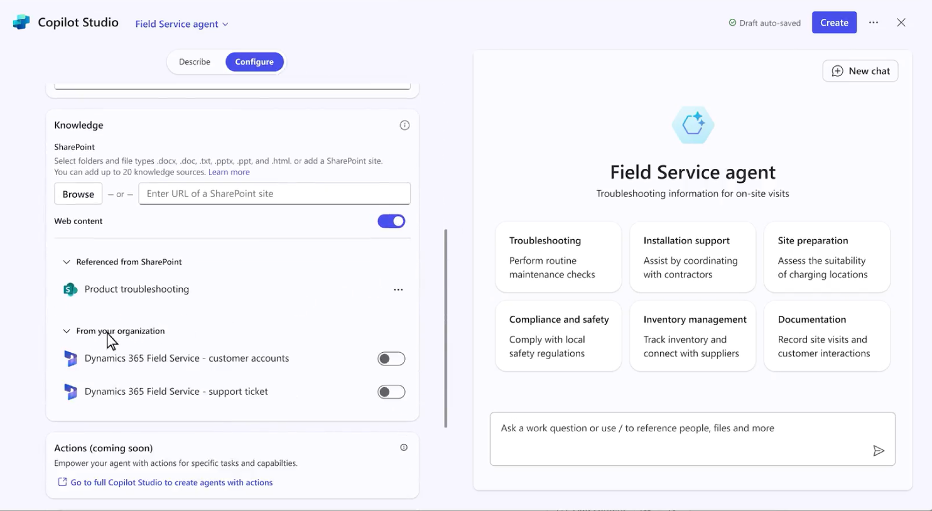
Why AI now? (2 of 2)
2
AI is evolving rapidly—what we see today is just the beginning. Those who experiment early will adapt more easily as AI continues to advance.
For example,
AI Agents (also known as virtual assistants) are smart software tools that can assist with various tasks based on your needs.
With Copilot Agent, users can now create basic AI agents without coding, enabling automation and efficiency in their roles.
Notes:
1 min | [Slide: Why Does AI Matter Now? Part 2] (Slide 13)
Second, AI isn’t just catching up—it’s accelerating. The AI tools available today are already impressive, but the advancements we’ll see in the next few years will completely reshape how we work.
Organizations that embrace AI now unlock creativity, efficiency, and productivity, staying ahead in a world where AI will only get smarter and more powerful.
Now, imagine having a virtual assistant that understands your work and can instantly answer your specific questions based on your role and context.
This is where AI Agents come in. Also known as virtual assistants, these smart software tools assist with tasks based on your needs.
AI Agents can be built using your knowledge base, allowing them to provide answers without the need to search through multiple documents.
For example, with Copilot Agent, users can now create basic AI agents without coding, enabling automation and efficiency in their roles.
Those who experiment early will adapt more easily as AI continues to advance. The more you experiment with AI now, the easier it will be to integrate new capabilities as they evolve.

Slide 14
Meet your AI work buddy
Examples of how AI can help you with everyday tasks at work
Meeting & Collaboration
Content Generation
Personal Productivity
Automated agenda preparation
Recap. a meeting or chat
Transform existing text into another form
Create first drafts
Author/get coaching on a new email
Q&A and ideas generation
in chat
Meeting summary and notes
Live sentiment analysis
Edit and tailor content/ formatting
Add more context
Suggested reply to threads
Summarize notes
Next Step actions
Summarize deck content
Summarize long texts
Summarize long threads
Create to-do lists
Language translation
Ask questions about a meeting or chat
Collaborative brainstorming
Extract next steps
Ask questions about document content
Notes:
1 min | [Slide: How AI Can Help You Today] (Slide 14)
Now, while we’re all excited about the future of AI, let’s focus on something more practical—how AI can help us today.
Here are some everyday tasks where AI can be a game-changer:
Generating meeting summaries and notes. No more scrambling to write everything down—AI can extract key points for you.
Translating languages and recapping meetings. Keeping teams aligned across different regions has never been easier.
Transforming text into different formats. Whether you need to reformat a report or tailor content for different audiences, AI can do it in seconds.
Brainstorming and creative ideation. AI can help generate fresh ideas, refine your work, and even act as a creative partner.
Providing coaching and workflow suggestions. Need help structuring an email? Summarizing a document? AI can guide you step by step.
If you think of AI as your smart work buddy, you’ll start to see how it can assist you every single day.
It’s not about replacing the way you work—it’s about enhancing your abilities, reducing busywork, and freeing you up to focus on what truly matters.

Slide 15
3: Solve real-life work problems with AI
Discover your AI Kickstarter
Notes:
30 sec | [Opening Scene: Instructor on camera, transitioning smoothly from the previous segment.]
Instructor: Now that we've explored how AI can assist you in your daily tasks, let's take a moment to look at the bigger picture.
We’ve talked about the potential of AI, but how are organizations actually using AI to drive real impact?
To answer that, we’ll explore some real-world case examples—how businesses are using AI to solve challenges, improve productivity, and create real value.

Slide 16






Businesses are transforming the way they work with AI
Real-life examples of AI applications in business
Productivity Gains
Efficiency & Optimization
Innovation & Customer Value
Increased speed, scalability​, and timesaving for more complex problems
Streamlined workflows, improved accuracy, and reduced operational costs
Business breakthroughs and increased value-add to customers
92 minutes saved per week per person
Nearly 2 weeks per person annually
Sellers increased outbound call by 40% due to process efficiencies
Projected $50M annual revenue gains
20,000 employees across functions accelerate rare disease research.
Automate shipping invoice analysis
Anticipate millions of dollars saved on shipping operations in first year
Marketing team’s time to create new content reduced by 67%
7 months of work completed in 7 weeks
12% faster case resolution
16% decrease in case handling time
Non-exhaustive list
Notes:
1 min | [Slide: AI in Action – Real-World Impact] (Slide 16)
Across industries, AI is changing the way companies operate, helping them move faster, work smarter, and innovate more effectively.
Here are three key ways AI is driving transformation today:
Boosting productivity with AI-enabled workflows – Organizations are using AI to increase speed, scalability, and efficiency, allowing teams to tackle complex problems faster.
Optimizing workflows for accuracy and efficiency – AI is helping businesses automate repetitive processes, reduce human error, and free up employees to focus on higher-value work.
Creating business breakthroughs and enhancing customer experiences – AI is enabling businesses to personalize interactions, improve response times, and add more value to customers.
Let’s take a closer look at one example. (Transition to the next slide)

Slide 17

Case example: before vs. after AI
Slashed time to market by 75%
Before AI
After AI
Customer Insights & Strategy
Relied on multiple internal and external reports to synthesize customer insights
Use Copilot to analyze market trends and customer insights
Demand Generation
Only specialists could pull data and analyze campaign performance
Use Copilot to do full-funnel analysis
Relied on expensive third-party translation services
Use Copilot to aid translation and localization
Campaign execution
Only specialists could pull data and analyze campaign performance
Use Copilot to supply management analysis and budget management
Content Creation
Creating campaign content took up to 6 months
Use Copilot to draft and optimize content, review for inclusivity
Source: Finastra’s Copilot revolution: How AI is reshaping B2B software marketing for the financial services sector
Notes:
1 min | [Slide: Case Study – Finastra] (Slide 17)
One great example of AI impact comes from Finastra, a global financial services company.
Before AI:
Their marketing team had long content creation timelines—sometimes taking up to six months to develop campaign materials.
With so many layers of review and approvals, the process needed some improvements
They needed a way to speed up content creation while maintaining quality and inclusivity
After AI: By integrating Microsoft Copilot, the team was able to:
Generate and optimize content faster – Copilot helped them create high-quality drafts within minutes instead of weeks.
Ensure inclusivity in messaging – AI assisted in refining content to align with diverse audiences.
Streamline the review process – Reducing the back-and-forth between teams.
The Outcome:
Time-to-market was reduced by 75% – meaning they could launch campaigns much faster.
The team had more time to focus on strategy and creativity rather than getting stuck in repetitive tasks.
And this is just one case example—companies across industries are discovering new ways to leverage AI to increase efficiency and drive results.

Slide 18
Exploring opportunities for your own impact
Let’s get real and discover your “AI Kickstarter”
Meeting & Collaboration
Content Generation
Personal Productivity
Automated agenda preparation
Recap. A meeting or chat
Transform existing text into another form
Create first drafts
Author/get coaching on a new email
Q&A and ideas generation
in chat
Meeting summary and notes
Live sentiment analysis
Edit and tailor content/ formatting
Add more context
Suggested reply to threads
Summarize notes
Next Step actions
Language translation
Summarize deck content
Summarize long texts
Summarize long threads
Create to-do lists
Ask questions about a meeting or chat
Collaborative brainstorming
Extract next steps
Ask questions about document content
Notes:
2 min | [Slide: Your Turn – Finding Your AI Opportunity] (Slide 18)
Now that we’ve explored real-world applications of AI, let’s bring the focus back to you.
How can AI help you work smarter and drive impact in your own role?
To get started, let’s revisit some common AI use cases that can be applied across different industries and professions. Take a moment to scan through these examples on the screen.
Generating meeting summaries and notes – AI can automatically capture key points, action items, and next steps, so you never have to scramble for notes.
Drafting professional emails – Instead of spending time writing from scratch, AI can generate polished, structured responses in seconds.
Brainstorming and generating ideas – AI can help spark creativity and provide different angles for your projects.
Creating strategy documents and reports – AI can help structure content, summarize research, and format documents efficiently.
Developing checklists and project plans – AI can help organize workflows and ensure no critical steps are missed.
Take a few seconds to go through these examples and think: Which of these tasks could AI help YOU with?

Slide 19
for your ‘AI Kickstarter’
Lightbulb moments
Notes:
5 min | [Slides: Lightbulb moments for your AI Kickstarter] (Slides 19 - 23)
To help you find inspiration, let’s take a look at some short videos featuring Microsoft colleagues sharing how they are using AI in their own roles. These short videos will give you a glimpse into how professionals across different functions are integrating AI into their work.
As you watch, think about how AI might help you in a similar way.
[Play short videos in the next slides 19 – 22] AI Use Cases (Short Videos, <1 min each):
Drafting emails with AI – How AI speeds up email creation while keeping messages professional and on point.
Creating a strategy document – How AI helps structure and refine strategy documents efficiently.
Brainstorming new initiatives – How AI sparks creativity and expands possibilities.
Developing a checklist for your role – How AI assists in organizing tasks and workflows.

Slide 20
Lightbulb moment 1
NOTE: Play the Lightbulb example 1 video
Drafting emails with AI
“Can you help me draft an email for my leadership team highlighting my new campaign?”

Slide 21
Lightbulb moment 2
NOTE: Play the Lightbulb example 2 video
Creating a strategy document
“Can you provide me a draft template for an executive strategy document?”

Slide 22
Brainstorming ideas for new initiatives
NOTE: Play the Lightbulb example 3 video
Lightbulb moment 3
“What are the 5 ways that I can encourage well-being in our employees?”
“What about some wellbeing program ideas?”

Slide 23
Developing a checklist for your project
NOTE: Play the Lightbulb example 4 video
Lightbulb moment 4
“Can you turn this onboarding checklist into a comprehensive onboarding list? Include what I’ve already listed and produce in a table”

Slide 24

3-minute Self-reflection
Finding your “AI Kickstarter” opportunity
3 minutes
Guiding questions
Step 1
What are 1-2 tasks in your daily work that feel repetitive, manual, or frustrating?
Step 2
Which of these tasks, if automated or streamlined, would have the biggest impact on your productivity or reduce errors?
Step 3
If you freed up time by automating that task, how could you use it for higher-value work?
Once you are done, share one task you have identified in the chat!
Notes:
5 min | [Slide: Self-Reflection – Your AI Kickstarter] (Slide 24)
I hope these examples sparked some new ideas for how AI can support your work. Now, let’s take a moment to reflect on your own AI opportunity.
(3-Minute Guided Reflection Activity)
Take the next three minutes to answer these guiding questions to help you identify your own AI Kickstarter task:
What are 1-2 tasks in your daily work that feel repetitive, manual, or frustrating?
Which of these tasks, if automated or streamlined, would have the biggest impact on your productivity or reduce errors?
If you freed up time by automating that task, how could you use it for higher-value work?
Take a moment to jot down your thoughts. Once you are done, share one task you have identified in the chat!
[Instructor pauses for 3 minutes]
What did you identify as your AI Kickstarter? How did your peers approach theirs? Did you notice any common themes? I’m sure there were overlapping tasks, yet with unique variations based on different roles and contexts.
That’s what makes AI so fascinating—it’s not a one-size-fits-all tool, but a flexible assistant that adapts to your specific needs and ways of working.

Slide 25
4: Practice basic prompts with a mini exercise
Practice AI prompts with Copilot
Notes:
30 sec | [Opening Scene: Instructor on camera, transitioning smoothly from the previous segment.]
Instructor: Now that you’ve identified your AI Kickstarter task, it’s time to take the next step—learning how to communicate effectively with AI.
AI can be an incredible tool, but the quality of its responses depends on how we ask.
In this section, we’ll explore how to write effective prompts and give you a chance to practice and refine your own AI prompts.
So, let’s get started!

Slide 26

Writing effective prompts
The art of the prompt
Best practices
What do you want from Copilot?
Goal
1
Be specific about what you want Copilot to do. Clear goals lead to better responses.
Add some context to help Copilot understand what you're asking. Context makes the response more relevant.
Provide some examples for Copilot to use. This helps ground the response in the right context.
Let Copilot know how you want the response to be formatted. This sets clear expectations.
Context
Why do you need it and who is involved?
2
What information or samples do you want Copilot to use?
3
Source(s)
4
Expectations
How should Copilot respond to best fulfill your request?
Notes:
1.5 min | [Slide: The Power of Effective Prompting] (Slide 26)
Writing a good AI prompt is a bit like giving instructions to a smart assistant.
The clearer and more specific you are, the better results you’ll get.
Let’s go over four key principles that will help you craft better prompts for Copilot and other AI tools.
Be specific about what you want AI to do -- clear goals typically lead to better responses
Add some context to help AI understand what you are asking. Context makes the response more relevant
Provide examples. This helps ground the response in the right context
Let AI know how you want the response to be formatted. This sets clear expectations
To summarize, an effective prompt typically includes:
Goal – What do you want AI to do?
Context – What background information is helpful?
Example – Can you provide a reference or sample?
Expectation – How do you want the response structured?
Now, let’s see this in action with a quick live demo. (transition to the live demo segment)

Slide 27
What’s the difference? <Live demo>
This slide a placeholder for the live demo segment (see the ‘live demo’ instructions in the slide note)
For ILT/VILT, instructors can demo live (more preferred) OR use this slide (as a back-up) to discuss the difference between good vs. best prompt in Task 2
Let’s compare different prompts below
Task | Option A (Good) | (Better) | Option B (Best)
Rewrite Emails | Copilot, rewrite this email to be more formal: [email text]. | Copilot, rewrite this email to be more formal and concise: [email text]. | Copilot, rewrite this email to be more formal, concise, and persuasive: [email text].
Brainstorm newsletter topics for stakeholders | I need ideas for our company newsletter. Can you suggest some topics? | I’m working on our company newsletter. Can you suggest topics related to productivity tips? | "I’m working on our company newsletter. Can you suggest topics related to productivity tips for financial analysts? Each topic should include a compelling headline and a short summary that highlights its relevance to the audience."
One of the best ways to effectively work with AI is to ask it to refine the results by providing your feedback or asking follow-up questions—iterating the results.
Notes:
2 min | [1-Minute Live Demo: What’s the Difference?] (No slide)
Let’s experiment with different types of prompts to see how AI responds differently based on how we ask. I’m about to ask Copilot to help me generate ideas for our company newsletter.
I’ll try two different prompts—Option A and Option B. Think of the difference as I interact with Copilot with those prompts.
[Show instructor screen] Open a free Copilot chat and try this simple prompt:
Here’s my first attempt:
[Option A] "I need ideas for our company newsletter. Can you suggest some topics?"
[Instructor shares the AI-generated response on screen]
Now, let me try another option:
[Start a new Copilot chat and use this refined prompt]
[Option B] "I’m working on our company newsletter. Can you suggest topics related to productivity tips for financial analysts? Each topic should include a compelling headline and a short summary that highlights its relevance to the audience."
[Instructor shares the AI-generated response on screen.]
[Show different AI-generated responses side-by-side on screen]
Take a moment to compare both responses between Option A and Option B:
Which response did you find more useful? Drop your thoughts in the chat. What was the difference between Prompt Option A and Prompt Option B?
[Take a 30-sec pause]
The second prompt was more specific, included context, and gave AI a clear structure. This resulted in a more tailored and higher-quality response. Now, it’s your turn to try.

Slide 28
Mini interactive Exercise
Test your prompt for your AI Kickstarter
7 minutes
Instructions
Step 1
Open Microsoft Copilot: https://copilot.microsoft.com/
Step 2
For your AI Kickstarter task identified earlier, draft a prompt considering key elements of effective prompting, such as specificity, context, and desired format
Step 3
Evaluate the AI-generated responses:
Did Copilot understand your prompt correctly?
Is the response relevant and useful for your needs?
How can you refine your prompt to improve the response?
Step 4
Test if your feedback to Copilot improves the output quality
What was your ‘aha’ moment to improve your prompt for better results?
Share your biggest takeaway with peers!
Notes:
8 min | [Slide: interactive Practice – Test Your Prompt | 7 minutes] (Slide 28)
Now that we’ve explored the key principles of effective prompting, it’s time to put them into action. In this mini interactive exercise, you’ll draft and refine your own AI prompt, test it in Microsoft Copilot, and evaluate the quality of its response.
Let’s walk through the steps to get started:
Step 1: Open Microsoft Copilot
If you haven’t already, open Microsoft Copilot in your browser in another tab—this is where you’ll be testing your prompt. If you’re using Copilot for the first time, take a quick moment to get familiar with the interface. You’ll see a chat window where you can enter your prompt.
Step 2: Think About Your AI Kickstarter Task and Draft Your Prompt
Now, think back to the AI Kickstarter task you identified earlier in this session. Use this task as the foundation for your prompt. Now, write a prompt for your AI Kickstarter task.
Step 3: Evaluate your AI response
Once Copilot generates a response, take a critical look at the output by asking yourself these three key questions on the screen.
Step 4: Iterate for better results
One of the most powerful aspects of AI is iteration—your first prompt might not be perfect, and that’s okay! Provide feedback or ask follow-up questions to improve the output quality
Try to make more prompts for the remaining time.
[Pause and wait about 7 minutes]
Now that you’ve had time to experiment, let’s share your biggest ‘aha’ moment with peers in the chat -- the best way to learn the useful tips

Slide 29
5: Plan small, easy actions: Quick wins to work smarter
Kick off your AI journey with small AI habits
Notes:
30 sec | [Opening Scene: Instructor on camera, transitioning smoothly from the previous segment.]
Instructor: I hope you found the exercise helpful in getting started with basic prompts for your AI Kickstarter opportunity. Now, let’s talk about what comes next—the small, easy actions you can take to continue learning and growing on your AI journey.
Like any new skill, building AI skills takes practice—and the best way to get better is by developing AI habits that fit into your daily routine.
But before we dive into habit-building, let’s take a moment to discuss something equally important—using AI responsibly.

Slide 30
Working with your AI responsibly
Responsible AI Use: A Quick Checklist
Watch for common biases:
Use clear, specific prompts to get relevant AI outputs
Verify accuracy by cross-checking AI-generated content with trusted sources
Watch for biases (gender, racial, socioeconomic) and adjust content as needed
Edit AI-generated content to ensure clarity, fairness, and alignment with your goals.
Respect privacy—avoid sharing sensitive or personal data with AI tools
Be transparent—disclose AI-generated content in professional or public use.
Gender bias. AI systems can perpetuate gender stereotypes if trained on biased data.
Racial bias. AI systems can exhibit racial bias, leading to discriminatory outcomes.
Socioeconomic bias. AI systems can favor individuals from higher socioeconomic backgrounds.
Confirmation bias. AI models learn from existing patterns, so if the data is skewed, AI may reinforce one-sided perspectives.
Notes:
2 min | [Slide: Using AI Responsibly] (Slide 30)
As AI becomes more integrated into our daily work, it’s critical that we use it ethically, fairly, and responsibly.
As you continue experimenting with AI, here are some best practices to ensure that your AI-generated content is fair, trustworthy, and beneficial to society:
Use clear, specific prompts – The more precise your request, the more relevant the output.
Verify accuracy – Always fact-check AI-generated content using trusted sources.
Watch for biases – Be mindful of gender, racial, and socioeconomic biases in AI outputs.
Edit AI-generated content – Ensure clarity, fairness, and alignment with your goals.
Respect privacy – Never input sensitive or personal data into AI tools.
Be transparent – Disclose AI-generated content in professional or public use.
Understanding potential AI biases is crucial for ensuring fair and ethical AI usage.
Here are a few biases to watch out for when working with AI:
Gender Bias – AI can perpetuate stereotypes if trained on biased data. For example, a hiring algorithm may favor male candidates over female candidates due to historical data biases.
Racial Bias – AI systems can exhibit racial discrimination if not properly trained. Facial recognition systems may have higher error rates for people of color compared to white individuals.
Socioeconomic Bias – AI can sometimes favor individuals from higher-income backgrounds. For example, A credit-scoring algorithm might disproportionately approve wealthier applicants over those from lower-income neighborhoods.
Confirmation Bias – AI models learn from existing patterns, so if the data is skewed, AI may reinforce one-sided perspectives. If AI is trained mostly on Western media sources, it might provide answers lacking global perspectives.
By staying aware of potential biases, you can evaluate AI-generated content critically and adjust where needed.

Slide 31


Building your small, easy AI habits
What’s one AI habit you will start tomorrow?
Action planning
1
What’s one AI-powered task you want to try daily? (e.g., summarizing emails, drafting content)
How will you integrate it into your routine? (e.g., after checking emails, using AI to summarize key points)
How will you stay on track with your AI habit? (e.g., setting reminders, refining prompts, sharing insights)
2
3
Pro Tip: Write your AI habit on a sticky note📌,
set a reminder⏰ or find an accountability buddy👥!
Notes:
5 min | [Slide: Taking Action – Building Your AI Habits] (Slide 31)
Now that we’ve covered how to use AI responsibly, let’s talk about how you can integrate AI into your daily work.
Building an AI habit doesn’t have to be overwhelming. Start small, pick one or two simple actions, and stay consistent.
Here are some questions to guide your action plan:
What’s one AI habit you will start tomorrow?
What’s one AI-powered task you want to try daily? (Example: Summarizing emails, drafting content, generating meeting notes.)
How will you integrate it into your routine? (Example: Using AI to summarize emails right after checking your inbox.)
How will you stay on track with your AI habit? (Example: Setting reminders, refining prompts, sharing insights with a peer.)
[Take a pause for about 1-2 minutes]
Here’s what I’ve found really helpful when building AI habits:
Write it on a sticky note – Attach it to your monitor as a daily reminder.
Set a calendar reminder – Schedule 5-10 minutes a day for AI exploration.
Pick an accountability buddy – Find a colleague or connect with someone from this session to check in and share learnings
Remember, your AI journey isn’t about perfection—it’s about small, consistent steps that build your confidence and expertise over time.

Slide 32
Together, we have discussed:
7 min
Welcome & Unlock your AI mindset
6 min
Meet your AI work buddy: How AI can help you
15 min
Solve real-life work problems with AI: Discover your AI Kickstarter
12 min
Practice basic prompts with a mini exercise
10 min
Plan small, easy actions: Quick wins to work smarter
Notes:
1 min | [Slide: Quick Session Overview] (Slide 32)
Congratulations! You’ve completed this AI learning session!
For the past 50 minutes, you’ve:
Learned how AI can act as your work buddy to boost productivity.
Identified your own AI Kickstarter task to get started.
Explored real-world AI use cases driving business impact.
Practiced writing and refining AI prompts for better results.
Discovered small, easy actions to integrate AI into your daily workflow.
That’s a lot—and something to celebrate!

Slide 33

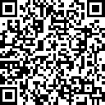


1
Confirm your participation
Verify your involvement on the attestation page for the GUINNESS WORLD RECORDS™ title attempt
https://aka.ms/TrainingAffirmation
Congratulations
You’ve achieved a new AI learning milestone
2
Share your success
Show off your achievement—post your milestone with #AISkillsFest
Notes:
1.5 min | [Closing & Reminder] (Slides 33)
To celebrate your achievement, make sure to claim your special badge—awarded by GUINNESS WORLD RECORDS through this AI Skills Fest event. How? Make sure to take steps on the screen. Take a moment to acknowledge your progress—this is a unique achievement!
Also, remember to share your success—you should feel proud of yourself achieving this milestone. Share what you learned in this session on LinkedIn or with your own network. Tag your colleagues and friends who might benefit from AI skills training. Use the hashtag #AISkillsFest to connect with others on their AI journey.
Thank you for joining this session and taking a step toward building AI skills. Remember:
Start small – Build habits one step at a time.
Stay curious – Keep testing and refining your AI skills.
Engage with others – AI is a learning journey best navigated together.
I hope this session has inspired you to continue exploring AI and finding ways to work smarter, not harder. Your AI journey is just beginning. Keep exploring, experimenting, and sharing your insights with your team!
Congratulations once again and thank you for being part of this AI learning experience!

Slide 34
Closing slide, dark
Notes:
Ending Slate to show at the end of the session

